Slide 1

INSY 695 – Enterprise Data Science
Football Player Valuation
Model Using Transfermarkt Data
Ruhi Mahendra Konstantin Volodin Adityo Das Gupta Rohana Habib Heidi Al Wakeel Robert Prattico Tyler Nagano Hai Nguyen

Slide 2








Meet the Team
Tyler Nagano
Business Analyst
Heidi Al-Wakeel
Data Scientist
Konstantin Volodin
Data Engineer
Robert Prattico
Business Analyst
Rohana Habib
Data Engineer
Ruhi Mahendra
ML Engineer
Hai Nguyen
Data Scientist
Adityo Das Gupta
Data Engineer

Slide 3
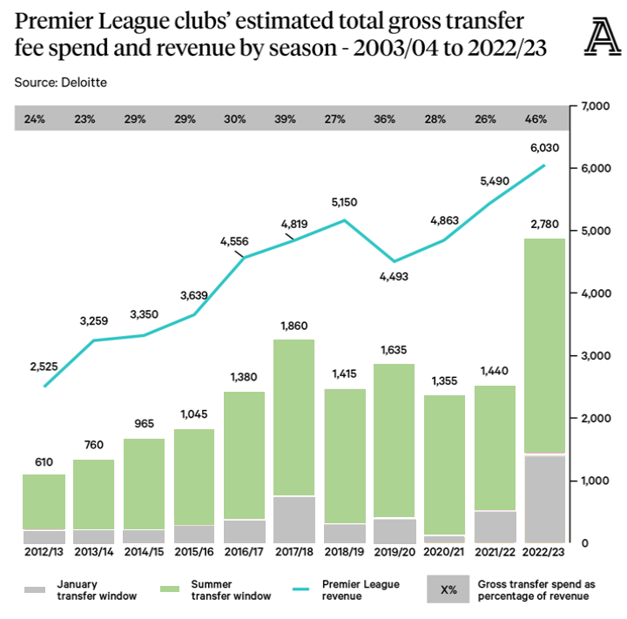
Business Context
Spending on player transfer fees has increased at an exponentially and unprecedentedly high rate in last 20 years.
On its own, English the Premier League increased its net transfer spend by 67% from 2021 to 2022 alone.
The burdens of increased spending falls on to the fans in the form of increased ticket prices and matchday concessions.
Over the last 25 years, the average price of a top-flight ticket has increased, in some instances, by more than 1,000%.
Additionally, some clubs have resorted to exorbitant amounts of debt, over commercialization, and fraudulent accounting practices to fund their player expenses.

Slide 4
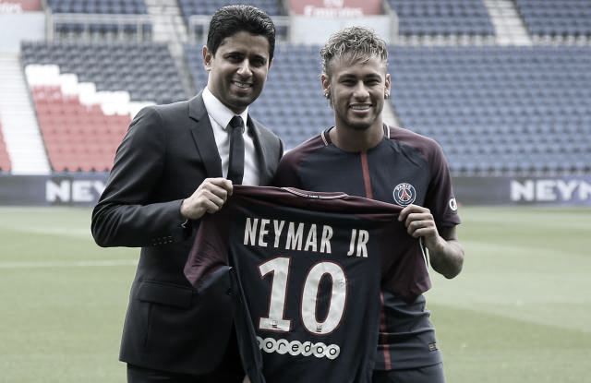
Project Objective
A tool is needed to help clubs better estimate a reasonable price to pay for a given player of interest.
An objective player price model will allow clubs to be more diligent in their spending.
Doing so will make football a more enjoyable and affordable experience for the fans and business more secure and sustainable for stakeholders in the long-term.

Slide 5
The Data
A model will be built from data stored on Transfermarkt, the most trusted source for data pertaining to seasonal player performances, characteristics and valuations.
appearances.csv
club_games.csv
clubs.csv
competitions.csv
game_events.csv
games.csv
player_valuations.csv
players.csv
60,000+ games from many seasons on all major competitions
400+ clubs from those competitions
28,000+ players from those clubs
300,000+ player market valuations historical records
1,000,000+ player appearance records from all games

Slide 6
Data Cleaning
Initial Pre-Processing
Advanced Imputation
Started with 8 CSV files and merged them together
Grouped the data by player and year
Aggregated some features based on the mean such as average minutes played, average assists, average goals
To fill in missing values for sub position, we looked at the most common sub position for each main position. Then, we used these most common sub positions to fill in any missing values
Created two lists: num_cols for numerical data and cat_cols for categorical data
Used IterativeImputer to impute missing values in the numerical columns by modelling each feature using other features in the data
Used fit() and transform() methods from SimpleImputer to impute missing values in the categorical columns by learning the most frequent value for each categorical column

Slide 7
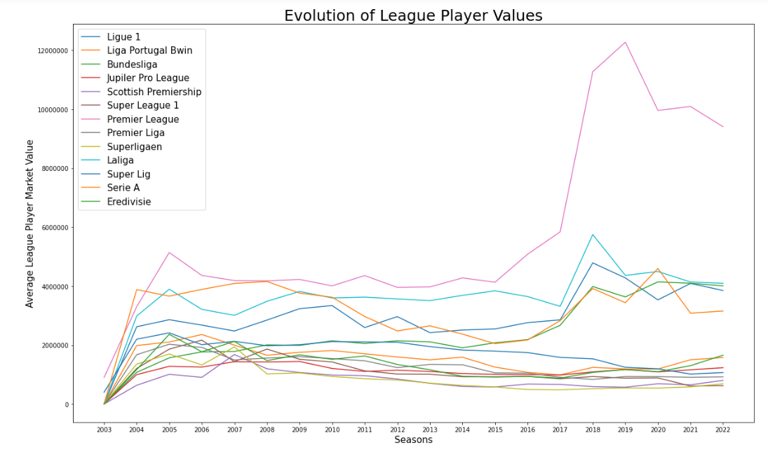




Exploratory Data Analysis
The most valuable players originate from the following nationalities
England
Brazil
France
Portugal
Since 2005, the English Premier League has had the most valuable players of any league. In the last 10 years, all other leagues have fallen behind to its dominance.
Do EPL players really have superior talent or do they benefit from the league’s status?

Slide 8
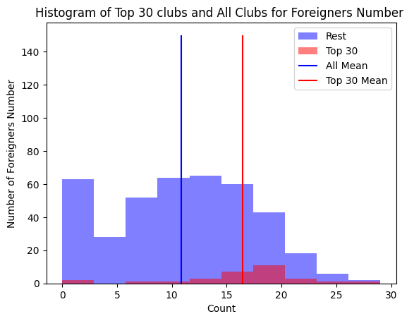
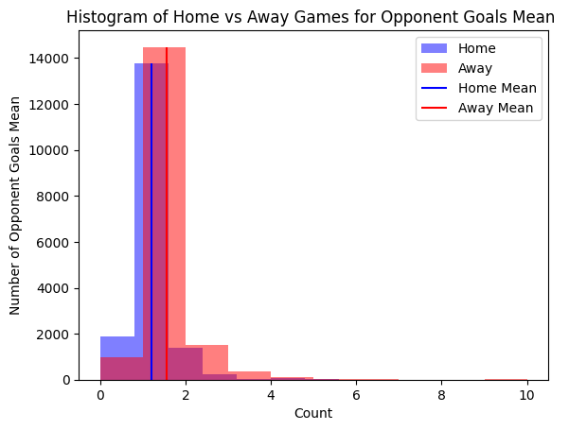
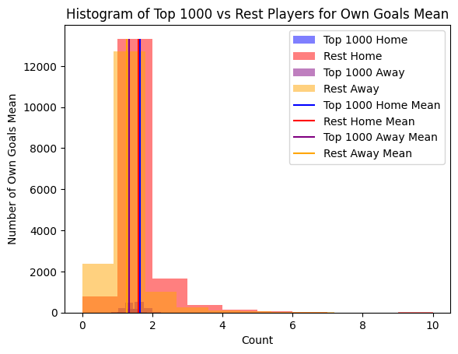
Exploratory Data Analysis
Top 30 Clubs by Market Value vs. Rest of Clubs
Players in Games played at Home vs. Games Played Away
Top 1000 Players vs Others
Foreign Born Greater in Top 30 Clubs
Players score 0.3 goals more at Home
More difference due to Top 1000 not Home versus Away

Slide 9
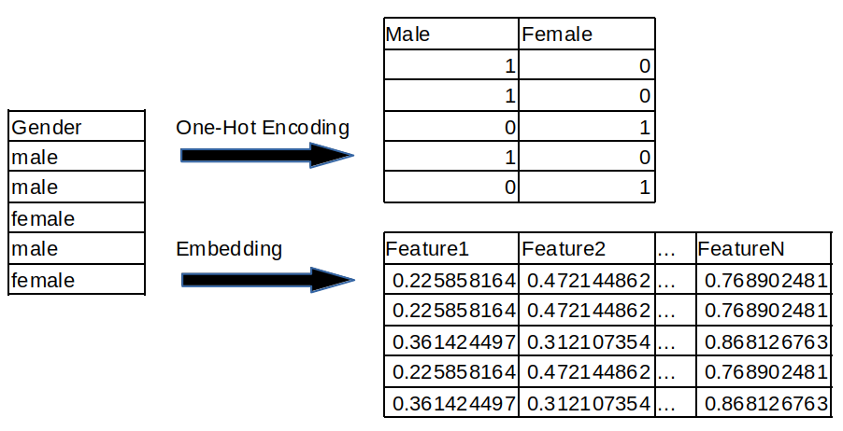
Feature Engineering
Entity Embedding
Used LabelEncoder to encode the categorical columns into numerical labels
For each categorical variable we defined the number of categories and embedding size
We created a tensor of categorical values and applied an embedding layer using nn.Embedding which maps each category to a dense vector in the embedded space
One-Hot Encoding
Created dummy variables for the foot column as this column had two categories: left and right so by one-hot encoding we created a binary variable of 1 for left and 0 otherwise

Slide 10
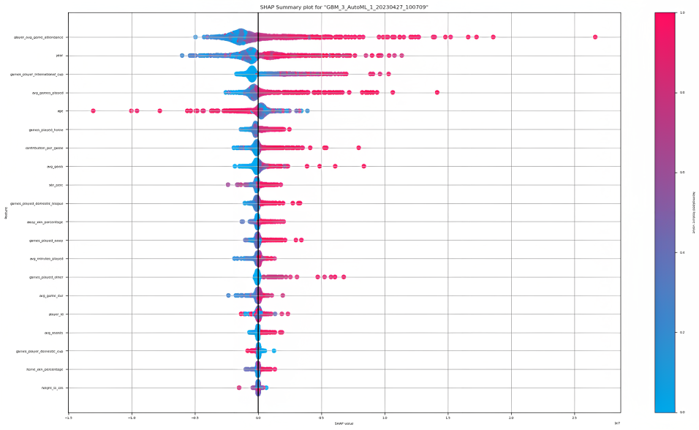
AutoML
Insights
We observed that the SHAP summary plot indicates a positive correlation between average game attendance and market value. As the SHAP values for the average game attendance feature increase, we see a corresponding increase in the SHAP values for the market value feature.
Similarly, the SHAP summary plot shows that there is a positive correlation between the number of games played and market value. As the SHAP values for the average games played feature increase, we observe an increase in the SHAP values for the market value feature.
In addition, the SHAP summary plot indicates that age has a negative impact on the market value of a player. As the SHAP values for the age feature increase, we see a corresponding decrease in the SHAP values for the market value feature.
Moreover, the SHAP summary plot suggests that game contribution, average number of goals, and win percentage are important factors that contribute to the market value of a player. We observe that these features tend to have positive SHAP values, indicating that higher values of these features are associated with higher market values for the players.

Slide 11
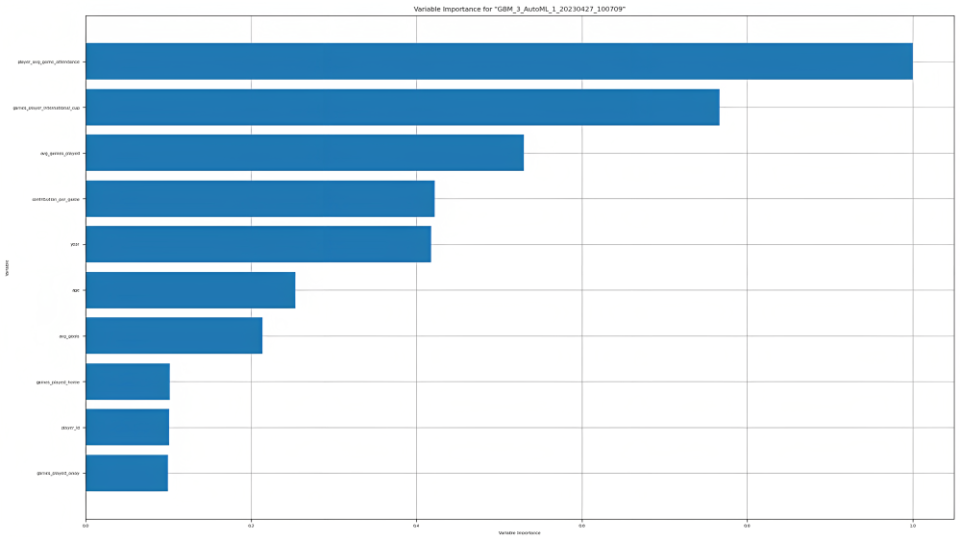
AutoML
The features with the highest variable importance scores indicate that they have the strongest relationship with the target variable. In other words, they are the most influential predictors in the model.
The variable importance score is typically calculated by assessing the impact of each feature on the model's performance. Features that contribute the most to the model's accuracy will have higher importance scores than those that contribute less.
Player average game attendance, whether a player participated in an international cup, and average games played contribute the most to the model

Slide 12
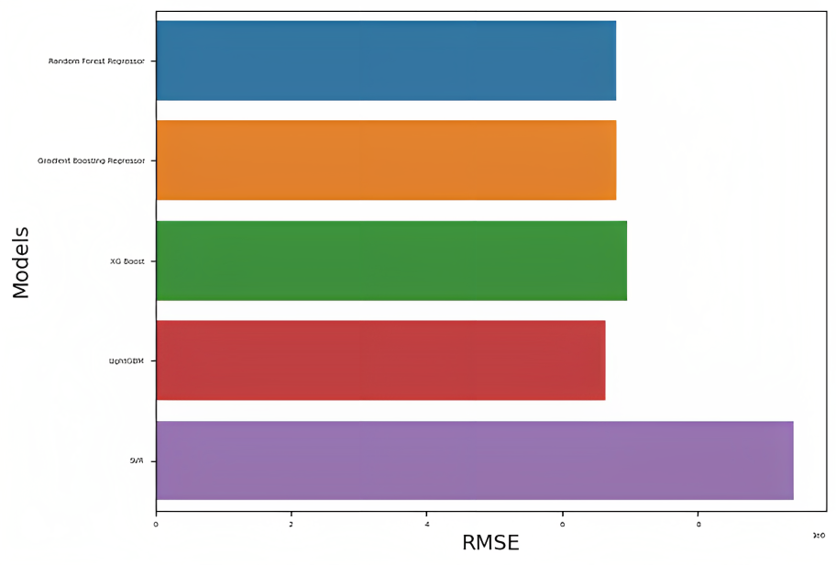
ML Models
We tested different regression models and used RMSE to evaluate their performance. The LightGBM model had the lowest RMSE, so We decided to hyperparameter optimize it to improve its performance.
By tuning the hyperparameters of the LightGBM model, we can potentially reduce the RMSE and improve the accuracy of the predictions.

Slide 13
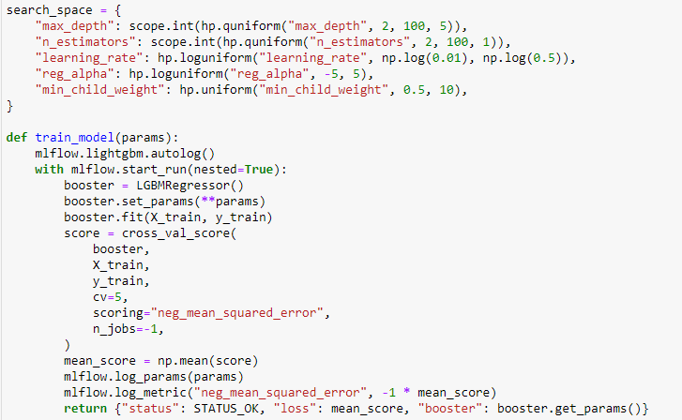
MLFlow – Hyperparameter Optimization
We use MLFlow to perform hyperparameter optimization on LGB Model
Parameter used: max_depth, n_estimators, learning_rate, reg_alpha, min_child_weight
We reran the model with the optimal hyperparameter and the MSE yielded was higher than the original model
Results of Hyperparameter Tuning
Hyperparameter | Optimal Value
learning_rate | 0.0146908
max_depth | 80
min_child_weight | 4.890633
n_estimators | 5
reg_alpha | 2.28401384

Slide 14
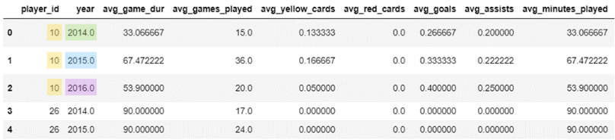
Data Leakage
Our data is categorized by player and year, meaning there are multiple entries of the same player in our dataset over different years
We used a ratio to split our data into both test and train sets, meaning data for the same player over different years may appear in both sets
Implications
Although the same player may appear in both test and train sets, because other features change YoY this won’t necessarily cause data leakage
However, year and age are highly correlated with one another and have high feature importance in predicting market value
To combat data leakage and overfitting, we should have used a time-based split rather than a ratio one to ensure that our model is tested on newer data than what is in the training set

Slide 15
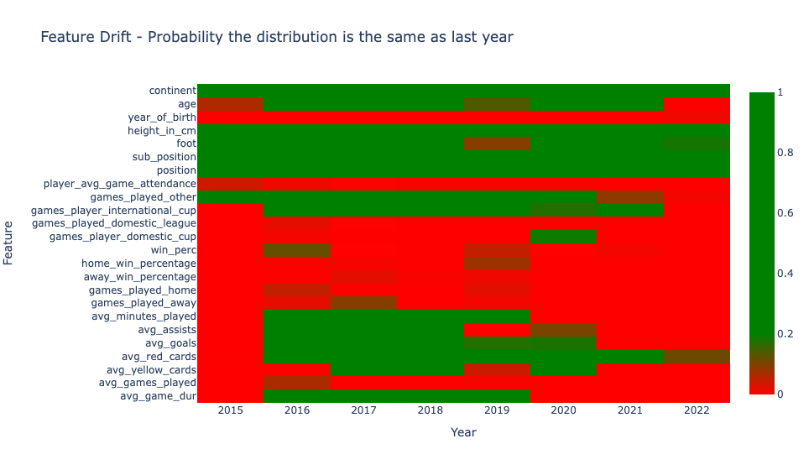
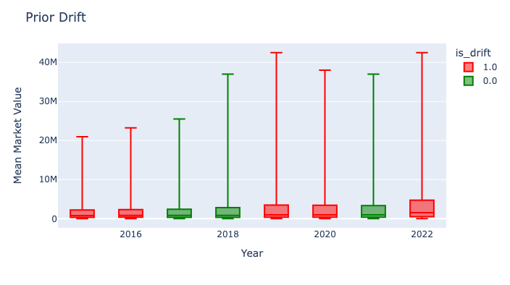
ML Model Tracking
Feature drift refers to a change in the distribution of the features over time.
We compared distribution of features over the years, using Kolmogorov-Smirnov for continuous and Chi-Squared for categorical features
The picture below shows that more than half the features had some drift from 2015 to 2022
Prior drift refers to a change in the distribution of the target over time.
We compared the distribution of target over the years, using Kolmogorov-Smirnov test and visualized the distribution (without outliers)
The picture shows that there have been many years with change in target distribution

Slide 16
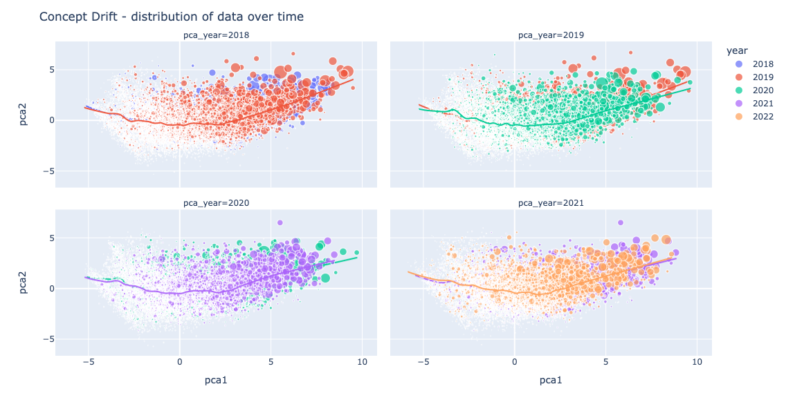
ML Model Tracking
Concept drift refers to a change in the underlying relationship between the input features and the target variable over time.
To compare the relationship over time we performed a PCA decomposition on a previous year and used previous’ year decomposition to transform next year.
We then plotted the two years together and saw if the relationship is different over the years.
There doesn’t appear to be significant changes in the underlying relationship year over year so that is less of a concern for our model
* Size indicates market value

Slide 17
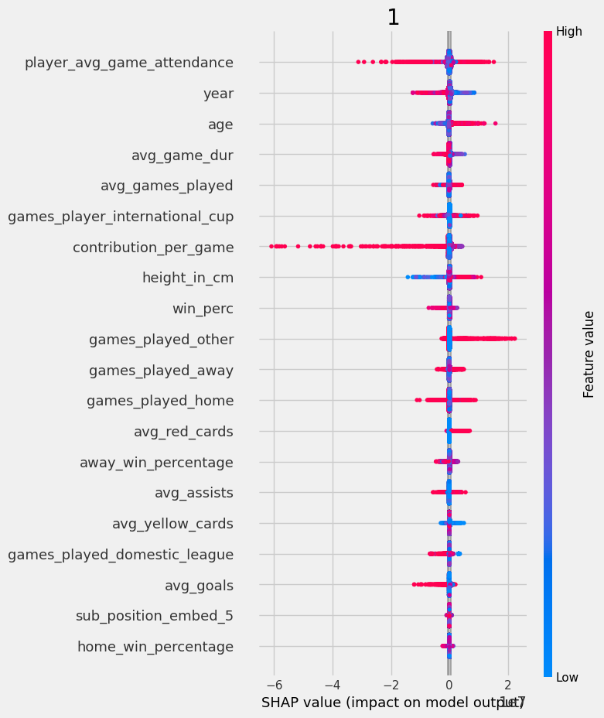
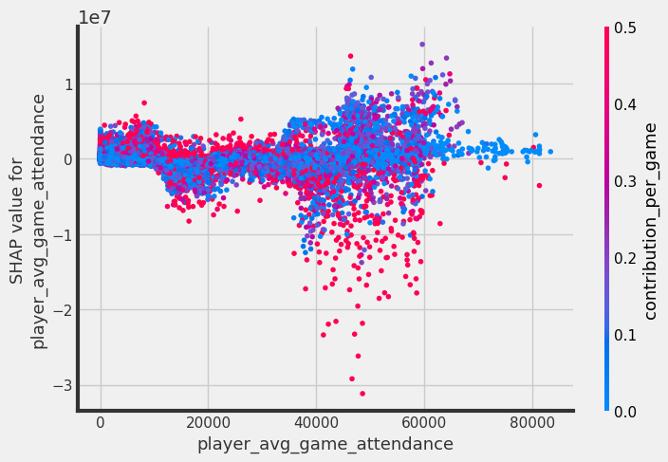
Causal Inference
We used the t learner to study the treatment effect of both footed players on the prediction of their valuation
We set the control group as players who can use both feet while test group was players who could either use left or right
It was observed that the players with high average attendance at the games were the biggest driving factors to bring the shap value up or down
Out of these players we saw that players who had a higher number of contributions per game (goals/assist) were bringing the shap value down while the ones with lesser contributions were around the mean or pulling the shap value above 0

Slide 18
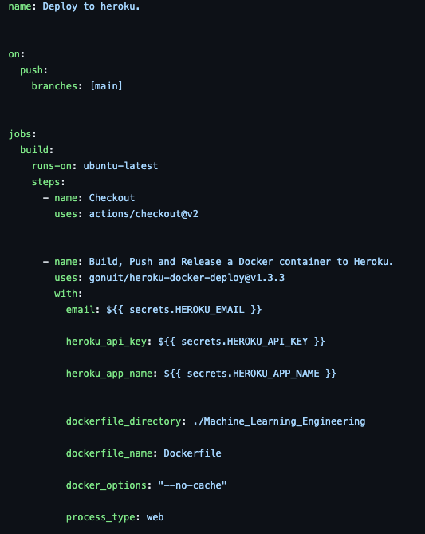
CI/CD – GitHub Actions
YAML file for CI/CD
GitHub Actions is an automation platform that allows developers to automate their software workflows directly within GitHub.
With GitHub Actions, developers can build, test, and deploy their code to different environments and perform various tasks, such as running tests, generating documentation, and deploying code to production, all in a customizable and automated way.
Our Steps:
Trigger whenever something is pushed onto GitHub main branch
2. Builds an environment on Ubuntu
3. Builds, pushes and releases a docker container onto Heroku to deploy Web App

Slide 19
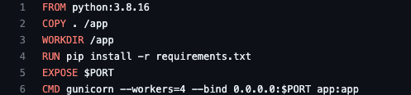
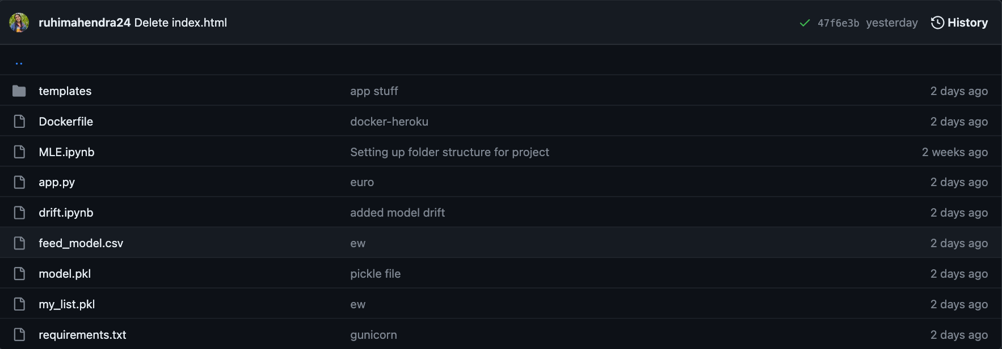
Deployment - Docker
Docker File
Docker File Components
FROM python:3.8.16: This specifies the base image to use for the Docker image, which is the official Python 3.8.16 image from Docker Hub.
COPY . /app: This copies the contents of the current directory (the "." means "current directory") to a directory named "/app" in the Docker image.
RUN pip install -r requirements.txt: This runs the command "pip install -r requirements.txt" within the Docker image, which installs the Python dependencies specified in the "requirements.txt" file located in the current directory.
WORKDIR /app: This sets the working directory to "/app" within the Docker image.
EXPOSE $PORT: This exposes the port specified in the environment variable "PORT" (which should be set when the container is started) to the host machine.
CMD gunicorn --workers=4 --bind 0.0.0.0:$PORT app:app: This specifies the command to run when the container is started. It runs Gunicorn (a Python web server) with 4 worker processes, binds to the IP address 0.0.0.0 (meaning it will listen on all network interfaces), and uses the port specified by the "PORT" environment variable. It also specifies that the "app" object should be imported from the "app" module.
Directory where Docker File
is stored

Slide 20
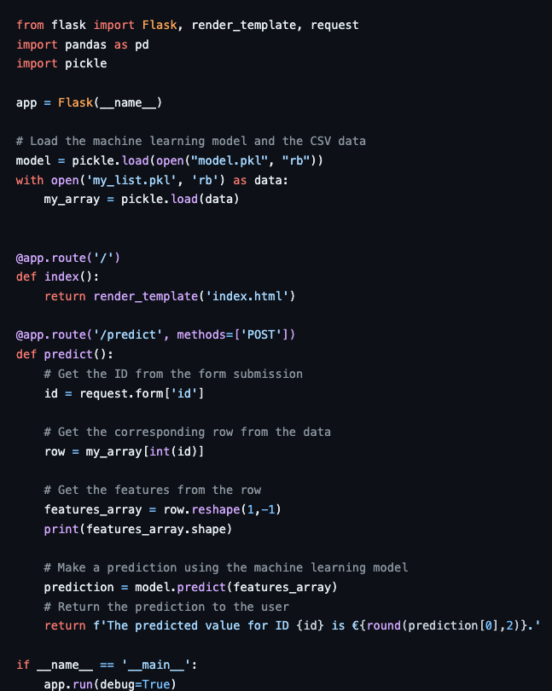
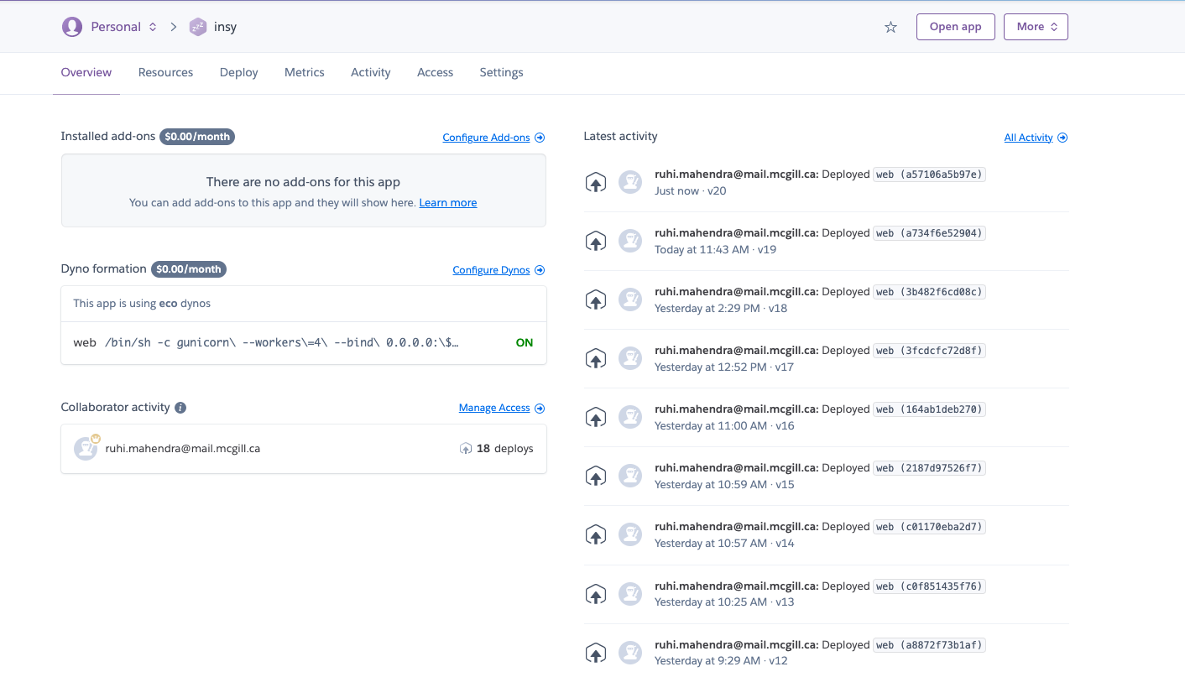
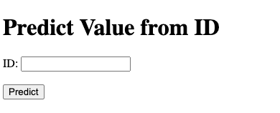
Deployment - Heroku
Using Heroku 'Dynos’
to deploy APP
App.py file to configure API
Heroku APP
APP LINK

Slide 21
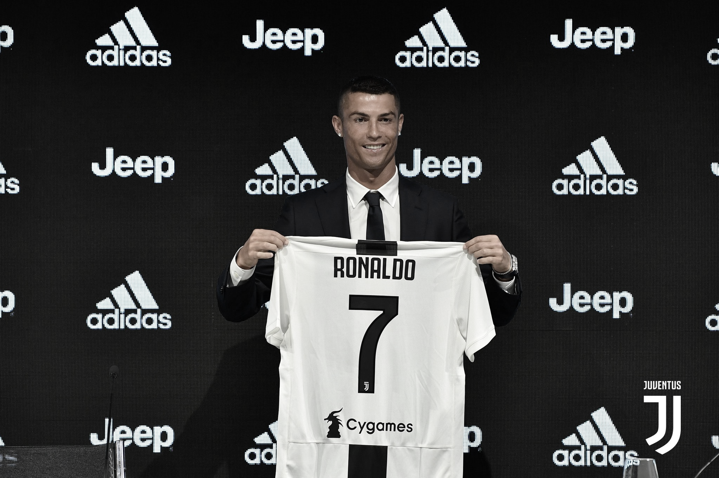
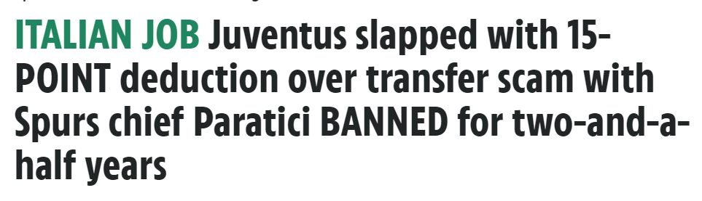
Business Insights
Putting the Model in Practice
In 2017, Juventus FC paid Real Madrid €117M , a player most considered to have been beyond his prime
While he did perform successfully for the team, many questioned whether Juventus paid a reasonable price for Ronaldo, or if his value was over-inflated due to the hype and status behind the player.
Since then, Juventus have under investigation for fraudulent accounting practices in their efforts to misrepresent the actual price they paid for players like Ronaldo to comply with financial regulations
According to our mode, Juventus in reality should have paid €98M for a player of Ronaldo’s caliber. This would have saved the club €19M and the damage to their reputation inflicted by the scandal.

Slide 22
Thank You
We look forward to receiving your feedback

